Slide 1
Architecture Assurance Method
Solution Architecture Development Life Cycle (SDLC) for Commercial IT Integration
Using the ICH Solution Architecture Integration Lab TM
John Weiler, E.D.
Interoperability Clearinghouse
john@ICHnet.org
703 768 0400
www.ICHnet.org/sail.htm

Slide 2
The COTS Integration Challenge
Exert from EDS Business Case Analysis: “The leveraging of our efforts with other parties through the formulation of a non-profit consortium is the most cost effective and efficient way of achieving the goal of interoperability assurance among heterogeneous systems. This ICH capability will augment our capability and provide us much more information about products, standards, and viable enterprise solution sets than we could ever realize through our own internal efforts.”

Slide 3
PMs lack the tools to make sound COTS acquisition decisions!
No common EA language to communicate business need to technology.
Current documentation methods do not result in action oriented solution “blueprints”.
No clear mapping of business drivers to standards or COTS solution offerings. Gap = Risk!
CIOs Feel...
No body of knowledge from which PM can evaluate competing COTS offerings.
Overwhelmed by offerings?
Ill-equipped to evaluate?
Out paced by market?
Interoperable?
Over hyped?
No mechanisms for assessing risks, composability or interoperability of COTS solution

Slide 4
The New IT Solution Paradigm Custom Development gives way to COTS Integration
Y e s t e r d a y
Design, Code, Test
COTS Paradigm shift dictates
EA driven SDLC process
Focus is Software Development
Code everything to spec
Timeframes 12-24 months
Complexity and rate of
change manageable (CMM)
Technology base Stable
Driven by IDEF, UML,
and antiquated EA methods
Software Components
& Off the Shelf Products
T o d a y
Model, Validate, Integrate
Focus on COTS Integration & Component Assembly
Architect, Evaluate, & Integrate
Timeframes are 12-24 weeks!
Interoperability not “knowable” in advance
Rate of change is high and accelerating

Slide 5
SAIL is designed to inform existing lifecycle processes (OMG, DoD 5000 series)
Investment Process /Architecture Project
Target IT
Assessment Framework
App.Port /
Respond to
Assess
Aligned per IT Strategy
Infra.
Business
Business
Initiatives
Change
Proposed Concept
Alignment
(SELECT)
Unacceptable Alignment
1
Develop
Assess
Business
Acceptable Alignment
Case
Business Case
Proposal
(CONTROL)
Acceptable
Assess
Alignment
Compliance
Technology
Scorecard
2
Enterprise
•
Define
3
Compliance
Design
•
Build
Patterns
•
Implement
TRM
(SELECT)
•
Operate
Standards
Project
Initialization
(EVALUATE)
Report
Compliance
Evaluation
Assessment
Evaluate
Unacceptable
4
Architecture
Compliance
Disapproved
Compliance
Unacceptable
Conformance
5
IRB
Audit Reports
Assess Waiver/
Architecture Roles
Report
Exception Request
Validation Points

Slide 6
CSF: Break down the acquisition lifecycle stove pipes Model Align Validate Integrate
Solution Architecture
Critical Success Factors
Architecture Driven
Begin with Business Drivers
Mission Aligned
Imbedded Metric
Interoperable
Normative
Non Prescriptive
Action Oriented
Acquisition Ready
Risk Adverse

Slide 7
ICH Solution Architecture Integration Lab A Collaboratory for the IT Value Chain
“... the concept of the Interoperability Clearinghouse is sound and vital. Its developing role as an honest broker of all interoperability technologies, no matter what the source, is especially needed. Such efforts should be supported by any organization that wants to stop putting all of its money into maintaining archaic software and obtuse data formats, and instead start focusing on bottom-line issues of productivity and cost-effective use of information technology.” Assessment by Leading FFRDC, 2000

Slide 8
The ICH Architecture Assurance Method Supporting the architecting, development and implementation of the Presidential Priority E-Gov Initiatives
Goals and Objectives:
To supplement existing (agency) SDLC methodologies
To provide a common framework supporting the architecting, development and implementation of Cross-Agency e-Gov initiatives
To increase the speed of transforming e-business requirements into interoperable solution suites that provide immediate ROI
To provide a formal process to enable Component-Based Architectures and the reuse of solution architectures
To provide agencies with a solution road-map that outlines the entire development lifecycle, and EA templates for justifying IT investments

Slide 9
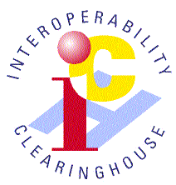
S.A.I.L.’s 3 phase Architecture Assurance process leverages best practices and implementation/testing results for sound IT decision making.
Users
Agency PMs
Phase 1:
Normalize
Business Requirements
Value
Chain
Analysis
Business Patterns
Business
Requirements,
Policy, &
Guidance
Industry Best Practices
Best
Practices
Lessons
Learned
Business Ref Models
Integrators
Consultants
Normalized
Business
Ref Models
Integration
Lesson Learned
Solution
Exist?
Phase 2:
SOA
Alignment
COTS
Knowledge Base
Solution
Patterns
Yes
Down select Solution Alternatives
no
Service Component
Common Criteria
Validated
Common
Criterion
Vendors
Establish
Arch. WG
Phase 3:
Analysis of
Alternatives
Testing Data and Evidence
New
Common
Criterion
A11-300
Solution
Architecture
Validated
AoA
Complete?
Normalized
Solution
Frameworks
Solution Architecture Validation
and Demonstrations
no
Yes
Validated Business
Cases & Solution
Acquisition Models;

Slide 10
The SDLC outlines a road-map that defines a common and consistent methodology for implementing eGov Initiatives
Strategy
Performance Measures, Objectives, Outcomes (PRM)
Business Objectives (BRM)
Funding, Partnering Strategies
Understanding the
Business
Discovery
Identify Best Practices and associated technology enablers
Existing Stake Holders, Business Processes, and Workflows
Existing Delivery and Access Channels (Portfolio)
Knowing What’s
Possible
Requirements
Must Have Functions, Features, and Info Exchanges
Short and Long-Term Requirements
Assessment of As-is state: Gap analysis
Model the Business
Define the Gaps
Architecture
Define Component Relationships to BRM
Wiring / Activity Diagrams, Data Arch
To-Be architecture ‘blueprints’
Establishing the
“building codes”
Acquisition
Define / Align Service Components
Component Common Criteria
Component SLA
Developing the
“Blueprints”
Integration
Acquire and Integrate
Validate and Test
Prototype, Implement, Deploy
Building The
Solution
Execution
Implement
Manage
re-Baseline
Execute and
Manage
Iterative Development
Value-Based Releases
Artifacts and Activities

Slide 11
Develop the business and performance strategy to support the implementation of the Initiative
Strategy
Activities
Artifacts
Engagement Questionnaire (getting started)
Define Performance Measures, Objectives, and Outcomes
Define Architecture Alignment (Agency, FEA / Ref Models)
Define Stakeholder Expectations
Distribute Partner Questionnaires, Surveys
Create Target Business Process, Use Cases
Define Funding Strategy
Business Case (what problem am I solving)
Vision Document
Program Management Plan
Business Architecture
Alignment to Federal Enterprise Architecture (FEA) Reference Models
Alignment to Agency Enterprise Architecture (EA)

Slide 12
Identify existing processes, workflow, and capabilities that can be leveraged
Discovery
Activities
Artifacts
Capture Cross-Agency / Industry Assets
Define Existing Technology and Components
Define Existing Processes and Workflow
Industry Capability and Business Alignment Matrix
Technology / Component Leverage Model (COTS capabilities by class)
Existing Processes and Workflow
Use Cases
Activity Diagrams
Industry Capabilities / Products (best practices documentation)

Slide 13
Establish short and long-term requirements, define critical success factors
Requirements
Activities
Artifacts
Cross-Agency Functionality (or must-have) Matrix
Define Legislative, Compliance Requirements
Security and Authentication
Privacy and Legal, Section 508, IATO/ATO
Define Technical Considerations
XML Enabled, Web Services, Access / Privilege Models
Define Short Term Functional Requirements
Define Long Term Functional Requirements
Critical Business Requirements
Technical Considerations
Functional Requirements (60-90 Days)
Functional Requirements (90+ Days)
System Requirements (based on business driver).
Weighted selection criteria

Slide 14
Create Solution Architecture
Architecture
Activities
Artifacts
Define Common and Unique Components (SRM)
Assess Existing Components That May Be Leveraged
Create Wiring, Linkages, Activity Diagrams
Create Data and Supporting Information
Access and Delivery Channel Requirements
Technical Reference Model
Service Component Architecture
Components, Linkages, and Locations
Wiring Diagrams
Value-Chain Participants
Data and Information Architecture
Data Model
Technical Architecture (mapping to BRM)
Target Process and Activity Model

Slide 15
Source the necessary solution components, establish agreements between agencies and vendors in architecture terms
Acquisition
Activities
Artifacts
Create Component Sourcing Strategy
Purchase / Leverage Service Components
Develop Solutions Architecture & Prototype
Define Legacy Integration requirements
Define Component Service Level Agreements
Buy, Build, Lease, Borrow
Component Sourcing Strategy
Vendors, Products
Service Level Agreements (SLA)
COTS Common Criteria profiles (map of features/functions to business drivers)
Past performance data (proof in the pudding) is necessary prerequisite

Slide 16
Develop and Implement the Initiative (two stages; prototype and full enterprise roll out)
Integration
Activities
Artifacts
Define Security and Performance Requirements
Define System Architecture (i.e., platforms, network, etc)
Prototype development and Testing
Rollout Considerations
Technical Implementation Plan
Security Specifications
System Architecture
Testing Plan
Software Development Artifacts
Coding Guidelines
Branding Requirements
Design Documentation
Manuals and Documentations

Slide 17
Develop and Implement the Initiative (two stages; prototype and full enterprise roll out)
Execution
Activities
Artifacts
Change and Configuration Management
Define Security and Performance Requirements
Identify Risks and Mitigation Activities
Support and Maintenance
Development and Implementation
Seat Management
Change Management Plan
Technical Implementation Plan
Performance Specifications
Risk Management Plan
Hosting and Support Requirements

Slide 18
ICH Architecture Assurance Method Aligning & vetting the inputs & outputs
OFFICE OF THE SECRETARY OF DEFENSE, DEPUTY CIO: "Since the value of the ICH to our programs increases rapidly through results sharing, we encourage the defense community and IT industry to participate directly in the public service initiative in terms of sponsorship and lessons learned"

Slide 19
ICH network enables and validates Reference Models that aligns common business needs with proven technical solutions
Reference Models
Associated Metrics
BRM
Business
Drivers &
Metrics
User/Integrator
Best Practices
Performance Metrics
Core Business
Mission Objectives
Business
Processes &
Infrastructure
Business Driven Top Down
Security Profiles
SAIL
Solution
Lexicon
Effectiveness/Efficiency
BRM
Service
Components
& Metrics
(SRM)
Appl Service
Components
Layer 1
Infrastructure
Service Components
Layer N
SAIL Solution Frameworks
Aligns with business needs
Common Criteria
Vendor
Solution
Templates
Interoperability,
Fit, Finish
BRM
Technical
Solution &
Metrics
Application
Layer 1
Common
Infrastructure
Layer M
Secure Solutions

Slide 20
Strength of Evidence = Risk Metrics Due diligence on features/functions reduces risk
85%
75%
$ & time
Risk
50%
Strength of Evidence
25%
Bi-directional
vendor claim
Functional/
conformance
testing
Integration
testing
Implementation
successes
Evidence Sources

Slide 21
Value Prop: Information Sharing and Collaboration reduces time, cost and risk of redundant IT research and validation efforts
High
Cost/time
Delta
S.A.I.L.
Vetting Process
Acceptable Risk Level
Risk
Delta
Confidence Level
Project A
Project B
Inconclusive
findings
Project C
Low
Strategy Architecture Discover Validation Acquisition Implementation
Validation Resources (cost & time line)
Redundant Market Research and Testing
SAIL Collaborative Research and Validation

Slide 22
SAIL’s accelerated process provides DHS executives with timely access to the information they need to make sound decisions
Problem
Identification
What’s the problem we’re trying to solve? Has it been solved before?
What are metric’s we’re trying to accomplish? Do they already exist?
What impact will this have on the citizen, business and stakeholders?
System Integrators
(Domain Expertise)
Process and Requirements
Creation of common service components templates
Identification of as is and target processes and infrastructure
Definition of “critical success factors”, business, and technical requirements
Pattern Creation and Component Alignment
Creation of usage patterns / use cases
Creation of business, technical, and infrastructure patterns
Identification of supporting components / products, capture of evidence of compliance
Criteria and Component Assessment
Creation of common criteria assessment definitions / factors
Creation of weighting algorithms (i.e., risk, cost, benefit, mission)
Evidence-based product assessment (using criteria definitions)
Accelerated Assessment Process (AAP)
Solution Architecture Integration Lab (SAIL)
(Component / Product Assessment / Objectivity)
Product Providers
(Evidence Assessment)
Component
Pattern Recognition
Down-selection of product(s) – based on clearly defined business patterns
Creation of notional “end state”
Identify linkages and potential “problem points”
Publishing of assessment criteria
Hand-over to client, perform weighting assessment
Development of alternatives ( product suites) and associated services
Publishing
Prototype selection of products (prior to procurements)
Prove results, creation of evidence
Engage in procurement process
Prototype

Slide 23
Solution Architecture Registry “propagation of intellectual capital that can assist in E-Government transformation” FEAPMO.gov

Slide 24
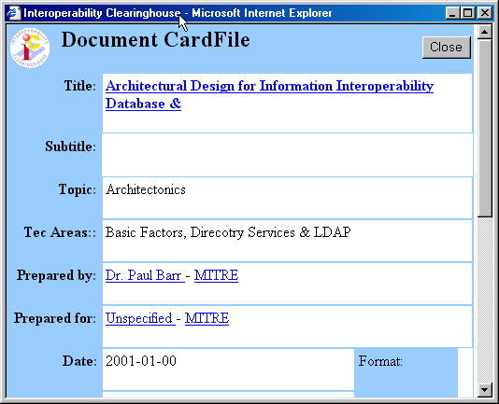
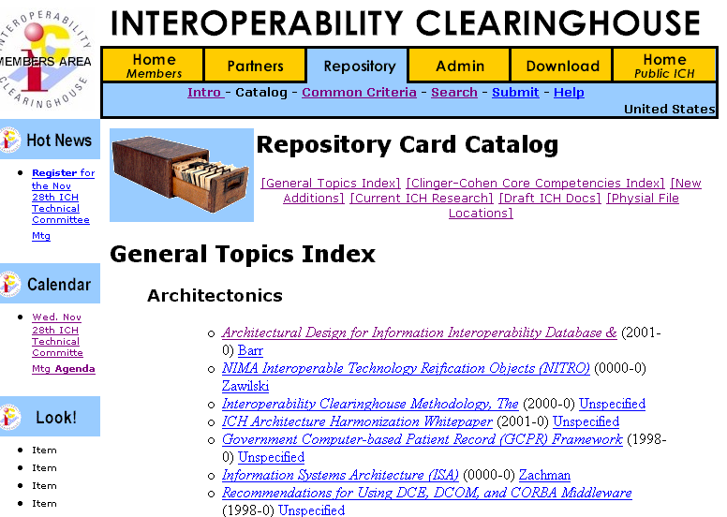
Example: OnLine Documents

Slide 25
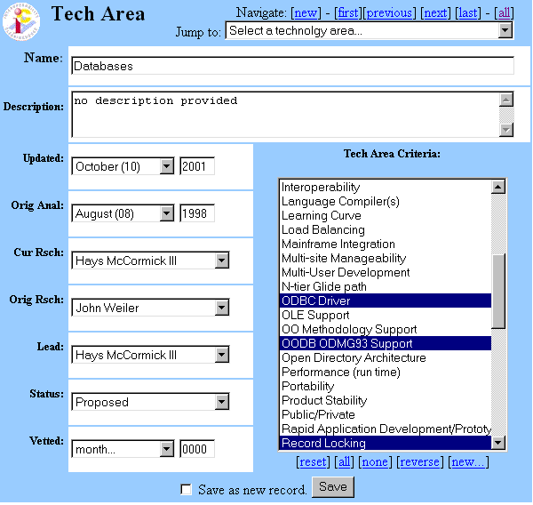
Example 2: Technology Area Criteria Selection

Slide 26
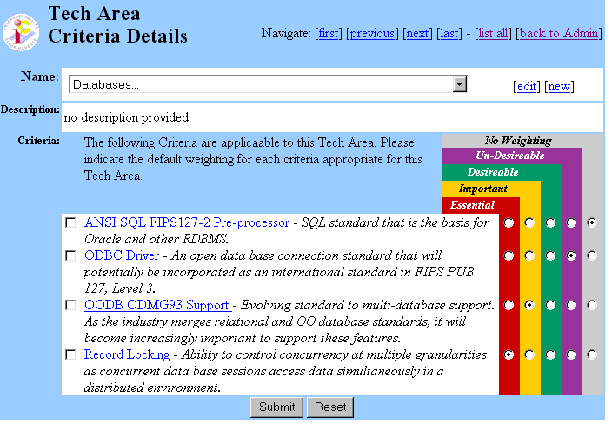
Example 2: Technology Area Criteria Management

Slide 27
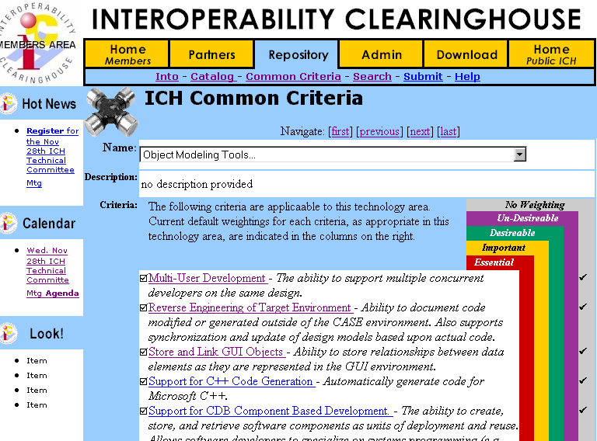
Example 2: Technology Area Viewing

Slide 28
Shared COTS Research: Eliminating Redundant Study efforts saves $$$$

Slide 29
Validation Process Flows
“As one of the leading advocates of open systems and interoperability, the OMG believes that the Interoperability Clearinghouse initiative will help users realize the benefits from our combined efforts”. OMG, Bill Hoffman, President

Slide 30
ISV Product Entry Workflow Workflow engine validates vendor entries
Validate
New
Features
Work Flow
Manager.
Product
Data Sheet
Standard
Specification
Conformance
Templates
COTS
Validation
Documented
Features
Composite
Features
Add New
Features
Create
UML
Template
Technology
Class Profile
Select
Existing
Features
New
Product/
Standard
Profiles
Establish
XML
URL Links
Standards
Directory
Product
Directory

Slide 31
Functional Validation Process
No
Vendor
Correction
60 Days
Pass?
Work Flow
Manager.
Send
to 3rd
Parties
Conformance
Testing
Yes
Vendor
Statements
No
Stds
Conform.
Statement
Functional
Testing
Testing
Results
Vendor
Concurs
Functional
Statement
3rd Party
Product
Statement
Send
Message to
Subscribers
Yes
Interop
Validation
Interop.
Statement
Interoperability
Testing
Attach to
Product
Profile
Update
Product
Directory

Slide 32
Interoperability Validation Process Industry validates Vendor Interworking Statements
Select
Products
Tested
Show Current
Product
Connections &
Functions
Existing
Links
?
Create new
Connection &
Component
Create
Product
Vendor Interop.
Submissions
Confirm
Connections
Confirm
Product
Functions
C4ISR
Attrib.
Determine
Level of Effort
& Interop.
Update
IC

Slide 33
Results from the ICH Process: Interoperable Web-Based Solution Architectures
Test Env. (Mercury Intl.)
Application Client
Browser, Native GUI
IDE Runtime (Javascript, PB, C++, JDK)
Application Server
Application Libs (C, DLL, MFC)
EJB
Application & System Runtime Modules
A
P
I
HP,
Sun, or
IBM
Unix
Database Server
NT
4.0
WS
Java JITC
JDBC API Client
(Connection Client)
or
TP Mntr.
(Encina++)
Directory Svrs.
RDBMS Server
Alpha,
Pentium
Pro
NT 4.0
Server
EJB Server (or CORBA Server)
X.500,
DNS, DHCP,
LDAP (v1.22)
Win 32 Subsystem | NT Device Drivers
Time Servicer
CDS
JDBC Driver OCI/INET
XA Lib.
(Encina)
Compilers (Java JITC)
or
Alpha
NT 40
Server
SQL Proxy Server (Connection Server)
RMI Runtime
IDL Stub
Win 32 Subsystem - NT Device Drivers
ebXML Server
J2EE Web Services
Security Service (PKI Certificate)
Posix Subsystem (Native or NT), Drivers
Security Service (PKI X.509)
Comms (TCP/IP) SSL
Comms (TCP/IP) SSL
MFI/
Gateway
Comms (TCP/IP) SSL
Systems Server
WEB Server
HP,
Sun, or
IBM
Unix
J2EE /Web Services
Directory Svrs.
RDBMS API (ODBC or JDBC)
Apha or
Pentium-
Pro
NT 4.0
Server
CDS Service
Backup
X.500, or
DNS,
DHCP
ODBC Driver (Intersolve) OCI/INET
RMI/
IIOP
Systems Management Server
(Patrol)
or
Alpha
NT 40
Server
ebXML API
Network Mgt.
(Open View)
Web Services
EJB Module
Posix Subsystem (Native or NT), Drivers
Win 32 Subsystem - NT Device Drivers
Comms (TCP/IP) SSL
Certificate Validation
Comms (TCP/IP)/ SSL

Slide 34
ICH Case Studies Assuring Implementation Success of Commercial Items
“The ICH repository data and analysis methodologies was very helpful in supporting a quick turn around for [Information Assurance] section of COTS security products. Highly detailed ICH technology domain and product evaluation data comprised over 60% of this urgently needed [architecture] report”. GCPR, Program Manager, Northrop Grumman/PRC

Slide 35
Case Study: World Largest Healthcare Project
Challenge: develop enterprise architecture for patient record integration
Applied ICH Architecture Immersion Program
Developed architecture validation criteria to GCPR Program Office
Developed product selection guidelines for Prime Contractor
Applied ICH Architecture Assurance Method
Outcomes
Enabled award based on unambiguous design specs
Augmented UML/MDA to address legacy and COTS capabilities
Ensured viability of chosen technologies
Met HIPPA requirements
Met security requirements
Provided integration framework for web infrastructure
Assured implementation success

Slide 36
Case Study: World Largest Media Company
Challenge: Select enterprise web infrastructure to integrate stovepipe applications
Applied ICH Solutions Validation Program
Performed architecture baseline assessment
Provided guidance and selection support for Web-app server, VPN, portal, last-mile wireless connectivity
Outcomes
Validated requirements against marketplace offerings
Improved confidence in technology decisions
Delayed VPN implementation
Purchased Web application server, database, and media products
Deployed system without a hitch
Significantly reduced time/cost to implementation

Slide 37
Case Study: World Largest Intelligence Agency
Challenge: means of integrating diverse communities via the web
Applied Architecture Validation Program
Developed common criteria for emerging portal market
Evaluated selection of Enterprise Portal for pilot project
Developed impact analysis on enterprise architecture
Maintained view of evolving marketplace
Outcomes
Enhanced and normalized portal selection criteria
Identified key features/functional areas for testing
Applied commercial best practices for successful production rollout
Improved understanding and alignment of technology to problem domain

Slide 38
Conclusion: The ICH Method is; Industry Developed, Government Approved, Business Driven, Standards-based, Collaborative COTS Selection Process ………...on GSA Schedule!
“...to help the 24 Presidential Priority E-Gov Initiatives and Federal Agencies with activities surrounding the technical and solution design of their e-Gov initiatives. ” Mark Forman

Slide 39
Need Help?
www.ICHnet.org
703 768 0400
info@ICHnet.org

